Slide 1
Eco audit

Slide 2
Green Spaces
Journeys
Energy
& Water
What we
consume
& waste

Slide 3
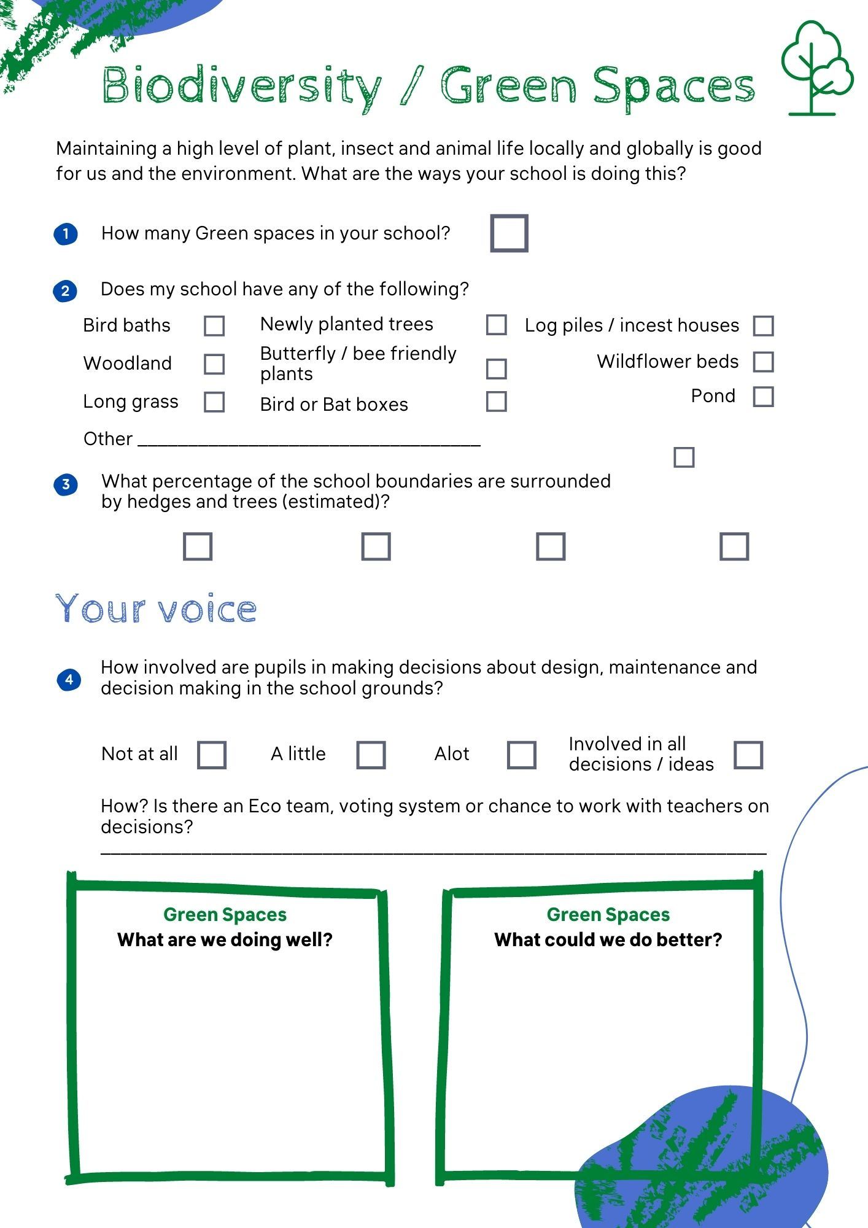
Eco Audit Worksheets

Slide 4
Green Spaces

Slide 5
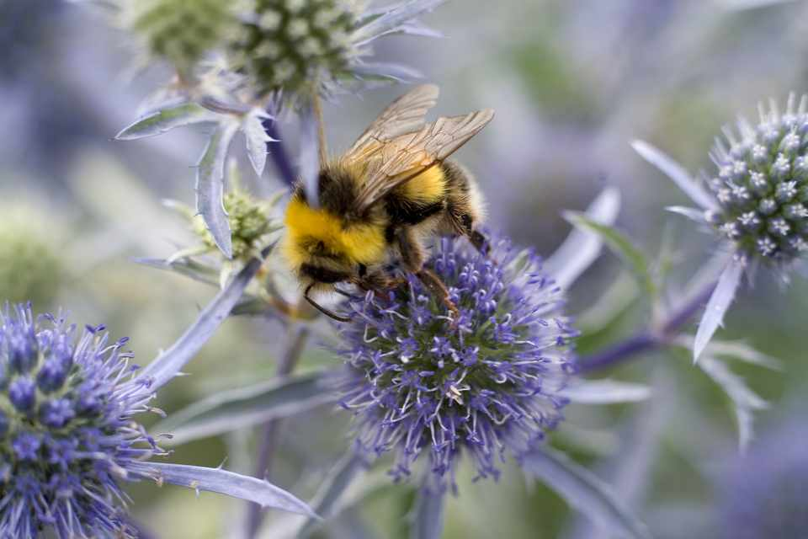
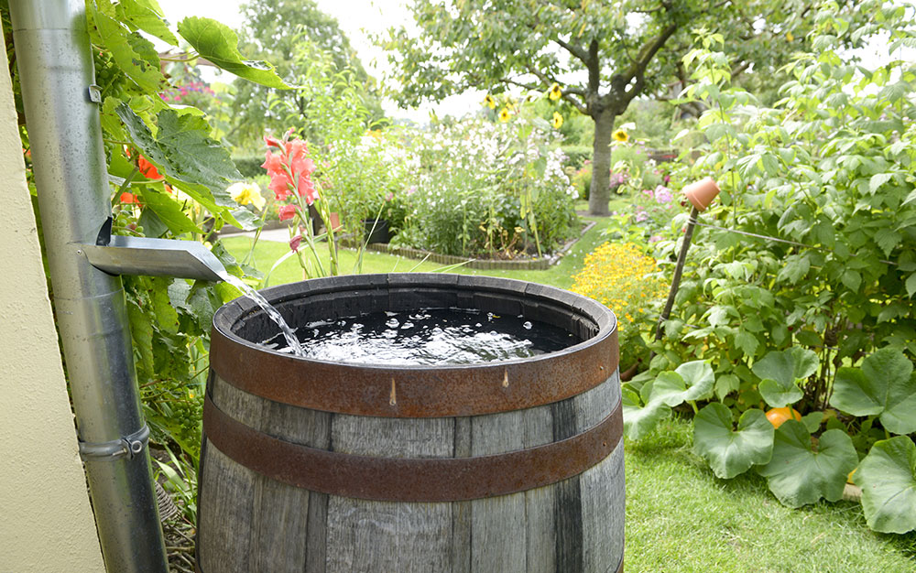
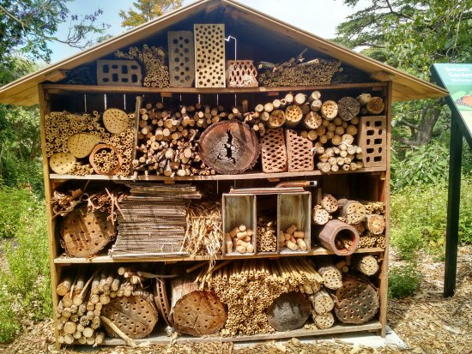
What are you doing well?

Slide 6
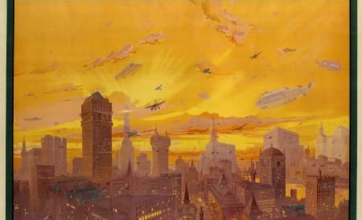
Journeys & Travel

Slide 7
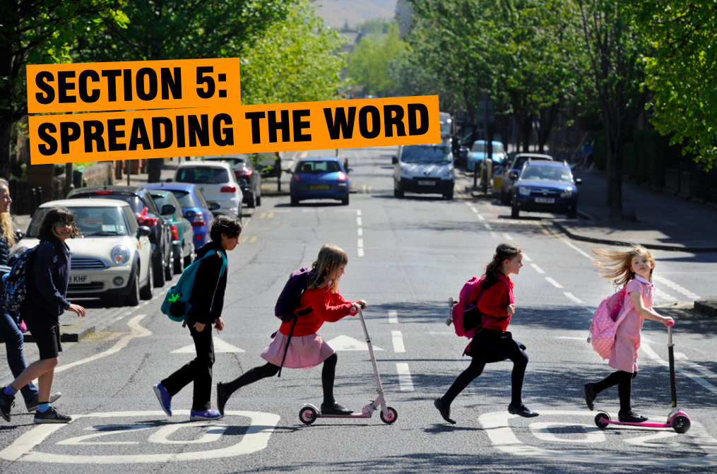
What new ideas do you have?

Slide 8
Energy & Water

Slide 9
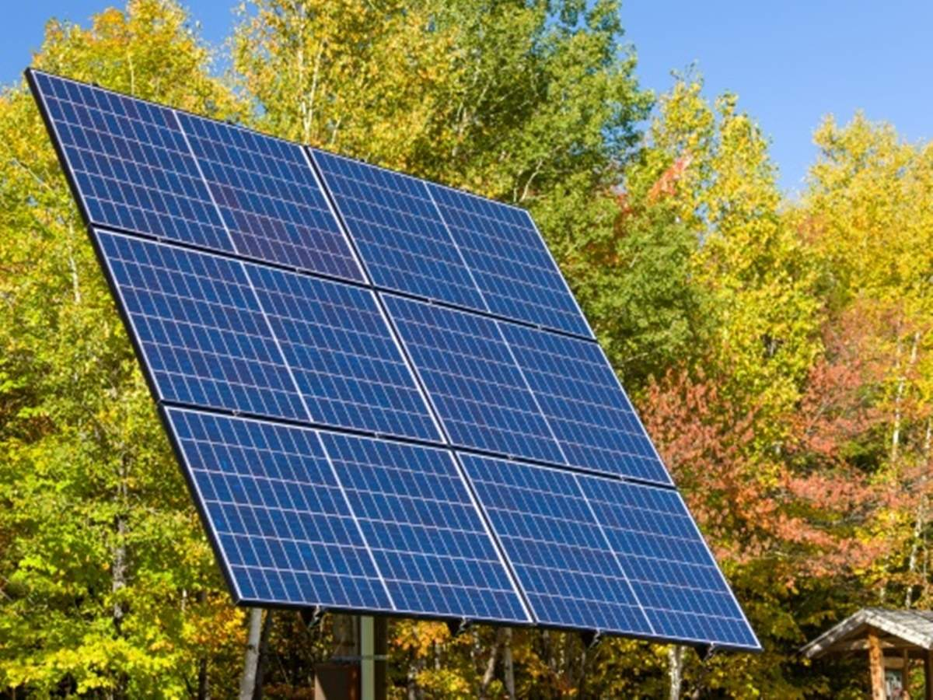
What could you be doing better?

Slide 10
What we consume and waste

Slide 11
Six Rs
Reduce
Rethink
Reuse
Refuse
Repair
Recycle

